Slide 1
Outsourcing Services to Central IT and the Cloud?
CALI June 2012

Slide 2
Survey Results
Posted Survey on Teknoids Listserv
Received 53 responses
Asked 13 Questions
First 6 questions concern reporting structure and governance
The remaining questions concern who provides services and how they are managed

Slide 3
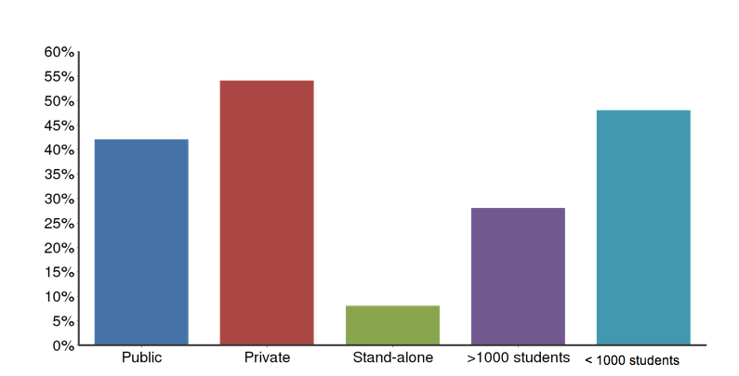
Survey Results
Is your Law School?
< 1000 students

Slide 4
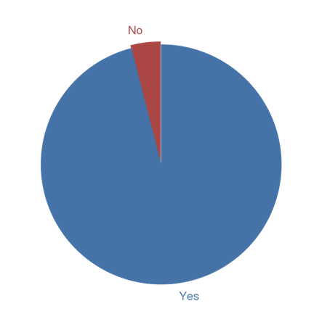
Does your Law School have an IT department?

Slide 5
Who does the head of the LS IT department report to?

Slide 6
If you have a reporting relationship to the central campus CIO, how long has this reporting structure been in place?

Slide 7
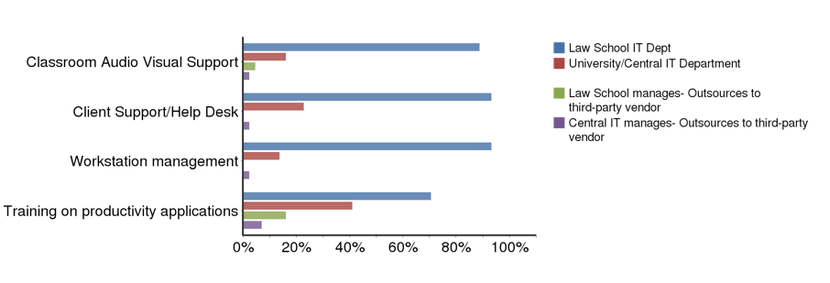
For each service listed below, please indicate who provides the service for your Law School faculty, staff and/or students?

Slide 8
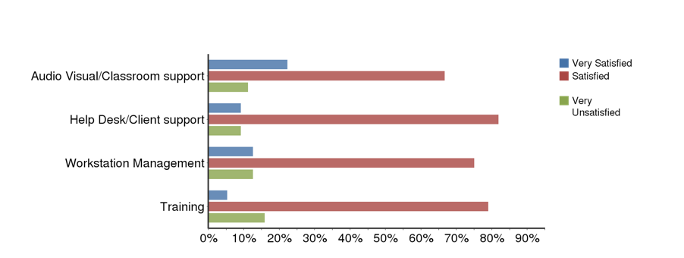
For those services provided by central IT, please indicate your level of satisfaction.

Slide 9
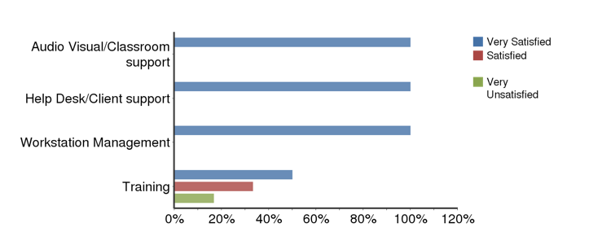
For those services provided by a third party vendor please indicate your level of satisfaction

Slide 10
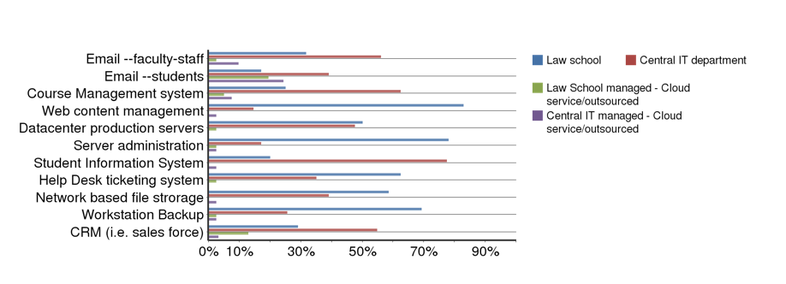
For each of the systems below please indicate who maintains/administers/houses the systems?

Slide 11
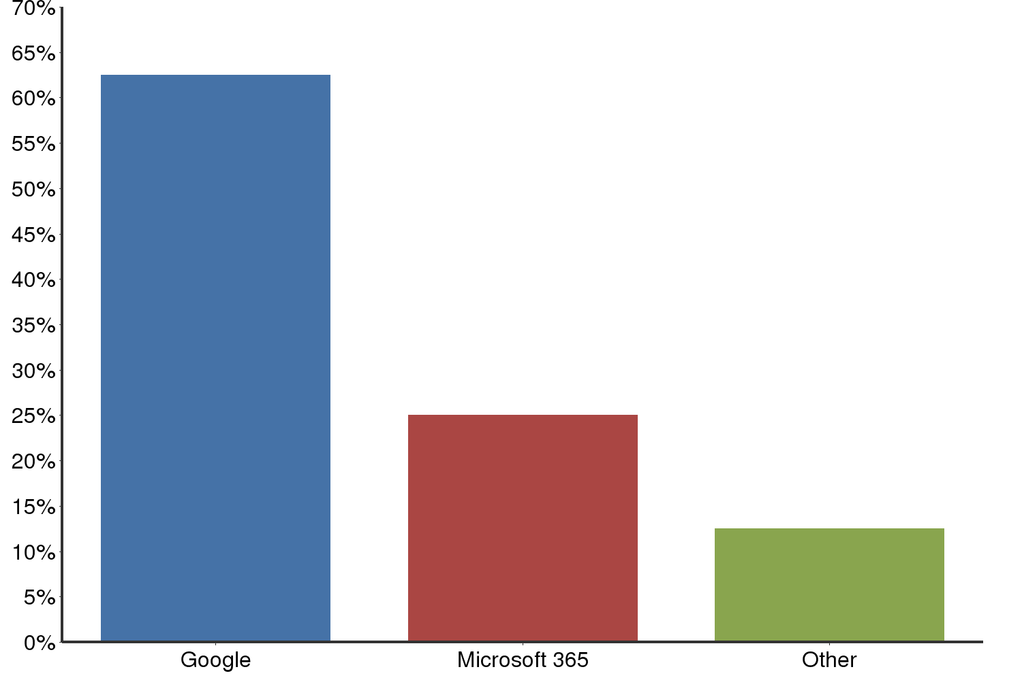
Who provides your cloud based email service

Slide 12
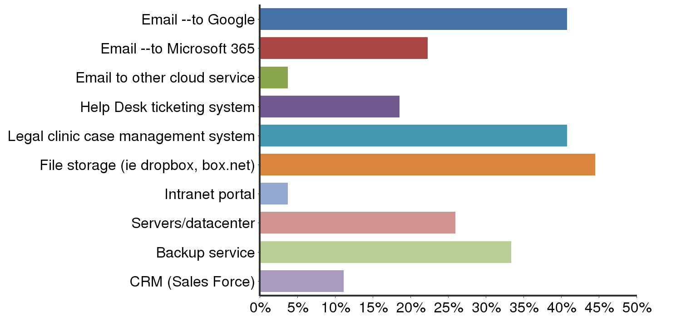
Is your law school or university planning to move or outsource any of the following services to the cloud in the next 12 months

Slide 13
Survey take-away
Not much change since 2 years ago in which services are outsourced to central IT
Increase in number of law school CIOs with some sort of reporting line to the central campus CIO.
Biggest change – is movement of systems and services to the external cloud.

Slide 14
What is a “common good” service?
Most campus users need the service
Can be Leveraged
Scalable
Free or low cost
Examples include:
Services and hardware/software purchasing
Data Center
Notes:
Common good could include strategically sourced software/hardware where the prime goal is to consolidate purchasing. Adobe creativity suite example.

Slide 15
Services that scale
Shared file storage (economy, standard, enhanced, secure)
Blade servers
Backup
Virtual Private Servers (VMware)
Network services including wireless
Firewall

Slide 16
Services that Scale, Cont.
Email
Calendar
Student information system
Database infrastructure
System-wide and campus licensing agreements
Business applications, collaboration tools, statistical packages, security software (identity finder, anti-virus, encryption), publishing software)

Slide 17
Advantages of outsourcing to central campus when it makes sense …
Possibility of lowering costs
Possibility of increased reliability depending on the service
Possibility of offering a service that would be difficult to offer internally due to resource (financial, technical or staffing) constraints
Possibility of freeing up a (fraction of a) percentage of a staff person’s time for a law-school specific need
Notes:
We are migrating from an Oracle database that we maintain to using campus Data Services’ Oracle instance. We’ll pay for a service, but no longer the Oracle license.
The red text is a question for the group—should we include this bullet??
KAM – How about Data Warehouses instead? And should we add Disaster Recovery Systems? Backups?

Slide 18
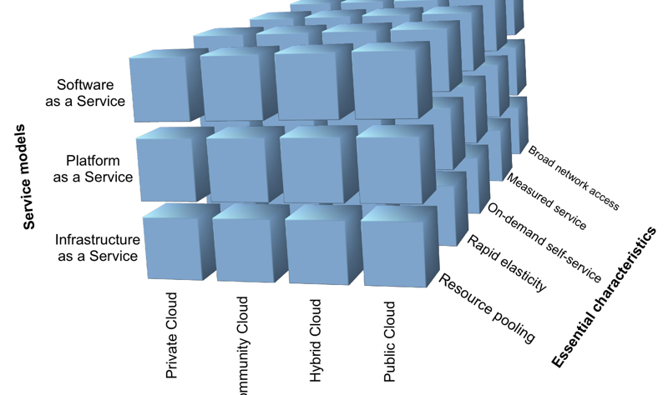
The Cloud

Slide 19
What our schools are sourcing to internal cloud
Email/calendaring/productivity applications
Student information systems (Banner; Kuali)
Learning management systems
Payroll/financials
University data center
Shared file storage and backup (server/workstation)
Blade servers, Vmware
Wired and wireless network services and firewalls
Notes:
We are migrating from an Oracle database that we maintain to using campus Data Services’ Oracle instance. We’ll pay for a service, but no longer the Oracle license.
The red text is a question for the group—should we include this bullet??
KAM – How about Data Warehouses instead? And should we add Disaster Recovery Systems? Backups?

Slide 20
What our schools are sourcing to external cloud
Email/calendaring/productivity applications (suites by Microsoft and Google)
Synchronizing file storage (Box.net; Dropbox)
Learning management systems (Sakai)
Exclusive contracts with external vendors to build out wireless and 3g capacity for campus
Payroll and timekeeping to Systemwide
Case management software (Clio)
Help desk software (Service Now)
Backup
CRM (SalesForce)
Career management system (Symplicity)

Slide 21
Sourcing “opportunities” not yet mentioned …
High performance computing clusters
Managed and/or virtualized workstations
Facilities management
Master calendar
Notes:
We are migrating from an Oracle database that we maintain to using campus Data Services’ Oracle instance. We’ll pay for a service, but no longer the Oracle license.
The red text is a question for the group—should we include this bullet??
KAM – How about Data Warehouses instead? And should we add Disaster Recovery Systems? Backups?

Slide 22
Managing Relationships
Make your needs known
Differences in academic calendar
Different needs for account creation
Participate in the University IT Governance
Law School CIOs should be on a central campus IT leadership team.
Staff should participate on central committees/workgroups that oversee or evaluate services you use or plan to use.
Notes:
KAM – We have to push very hard and advocate strongly to make sure that our staff are invited to be regular attendees of committees and working groups. Should we talk about how to accomplish this?

Slide 23
Managing Sourcing to Central IT
Insist on a Service Level Agreement, custom if necessary
Remove service layers by:
Ask for provisioning tools for account creation.
Insist new systems allow distribution of administration, so Law School IT can manage its users.
Have ability to turn-off/customize features for your users.
Notes:
External cloud providers: usually have campus security policy to have greater scrutiny on security and privacy and contractual obligations. With internal cloud, those are not required to be explicit, more accepted.

Slide 24
Managing the External Cloud
“Try and drop” strategy
Lowest hanging fruit for external cloud services is any data that is NOT regulated.
FTE have to be repurposed to manage the cloud. You will not reduce FTE.
Have a “return readiness,” “exit strategy” mindset.
Requires constant evaluation, NOT a situation of “make a decision and be done with it.” No cloud certifications exist and most cloud vendors will not allow you to audit them.
Notes:
Internal vs external differences
Internal campus stuff is internal hosted services not a cloud? Maybe VMware cluster. But database service is most definitely a hosted service.

Slide 25
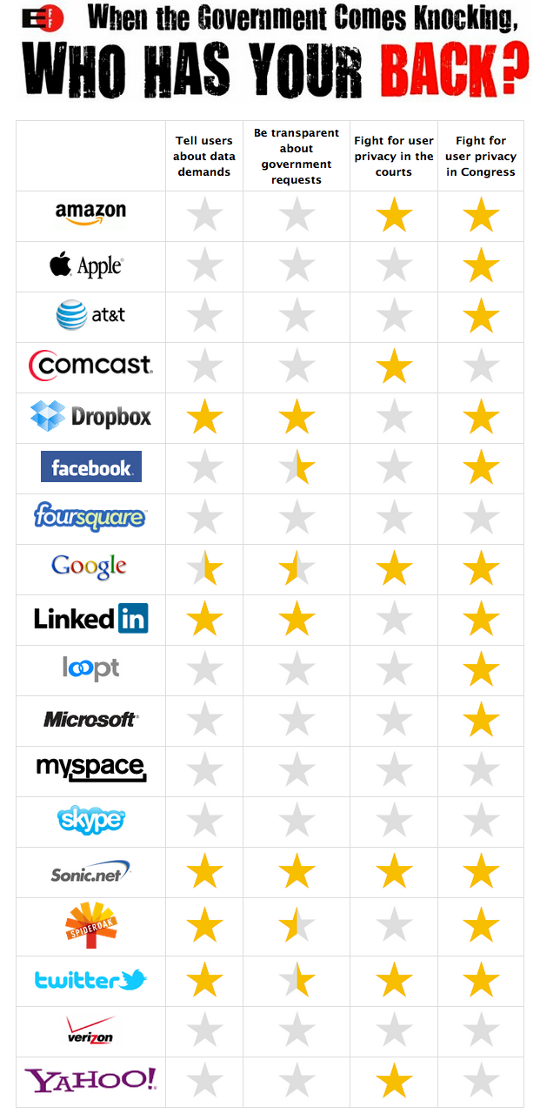

Slide 26
Examples of Law School IT and Central Campus Relationship Issues
Lack of trust in campus services developed over time by repeated service failures
Central campus attitude that professional schools have unreasonable demands that cost the campus money
Central campus IT staff work in hermetically sealed card key-protected facilities. Law school IT work next door to our faculty and staff constituents

Slide 27
Examples of Law School IT and Central Campus Relationship Issues
Systems are designed around “one offering” (e.g., support for campus wide email alias, when the law school wants to offer a law specific email alias in addition)
“We’ll get to that when we get to it” attitude regarding enhancements that are not valued by the undergraduate population
Disconnect between often young analysts/consultants entrusted with campus wide systems and the insight/wisdom offered by IT staff outside the central organization

Slide 28
What not to source
Help Desk
Media/Classroom Support
Web Services
Law School specific application development and support
Anything you can do better for less money
Notes:
Help Desk – we will always have a need for a much stronger service level agreement with our constituents than central campus because of who we serve. Star faculty, hierarchical top-down structures (compared to many central campus academic depts), clinical programs that function as 24/7 law offices, etc.
Our media/classroom support is more extensive than what central campus normally provides. Since the legal market imploded, clients are rejecting lawyers in their first year of practice. Law firms are wanting to hire students how have more professional skills including knowledge about courtroom and evidentiary technologies. We expect there will be more emphasis on classroom technology in the coming years. Many of our schools are forging relationships with foreign universities. We expect telepresence technology to play a key role in our distance learning programs. We are also beginning to explore the possibility of some online legal course offerings to expand access and provide certificate opportunities. Based on the fees that our central campuses currently charge, it would not be feasible to move aggressively in these directions without in-house staff.
The adoption of the paperless workflow in ACES2 has led some of our Admissions offices to go entirely paperless. We are regularly developing online forms and applications to support our Admissions process and our relationships with our prospective students.
KAM – *This, for WCL, includes web services, since virtually all of our in-house application development is web-based. Should

Slide 29
Critical Success factors
Partnering Planning Governance
Transparency (in governance, decision-making, prioritization of projects, recharge, etc.)
Communication

Slide 30
Challenges
Sense in central IT that centralization is inevitable
Contract negotiation with vendor
Consumerization of IT often means that “small shops” cannot compete with central or cloud systems for features
At the same time, features specific to the law school or a professional school environment are not valued globally
Notes:
Recharge rates
- Recharge rates at some campuses are based on the number of departments/users that adopt a service. You need to get assurances of price continuity for the first two-three years a service is in place.You may have to serve as an evangelist for some services and provide some technical assistance to other depts to get increased adoption and lower rates.
- It is important to understand the recharge rate formula for any campus service. You may have to prepare an apples to apples comparison for your CFO and your campus CIO to justify continuing to run an internal service that they view duplicative of a campus service.
Lobby your campus to adopt a policy that they will give a one year notice before abating any service.
Often we select a campus service because we trust the personnel running the service. What do you do when there is turnover and service degrades because of a lack of performance management on the part of central campus? Always have an exit strategy.
- “Leader of the pack” – As described earlier, we are often ahead of central campus in implementing new technologies. We invest, develop workflow, etc., and then eventually campus will offer the same service. When our service is not broken and works smoothly and meets our needs, we need to conduct a risk assessment about migrating to the campus service.

Slide 31
Cost versus value considerations …
Central costs can be hidden; “tax” for central IT can hide encroachment
Cost of disengagement
While less expensive, central services may be underfunded for the breadth of expectations placed upon them
There are break points for pricing; a central data center may save considerable money and offer greater sophistication – until it’s full

Slide 32
Budgeting and Cloud services
Cloud services move system costs from capital expense to an ongoing operating expense.
Need to carefully consider TCO
Cost of disengagement
Increase in licensing costs

Slide 33
The Case of Symplicity
“…readily acknowledged that each school owns their data and that the company would work with each school that wanted their existing data at anytime, regardless of the current circumstances…”
“…Through the reporting functionality you can recover all of your data except documents (student resumes, etc.)…”
“…If you prefer a data dump, Symplicity can accommodate that request for a fee depending on what you are seeking…”
“…Symplicity does want to ensure the institution maintains the dump confidential and does not disclose it to a third party. Specifically, the dump would provide a competitor with Symplicity’s proprietary data structure…”

Slide 34
Critical Success factors
Partnering Planning Governance
Transparency (in governance, decision-making, prioritization of projects, recharge, etc.)
Communication

Slide 35
Questions? Comments? Solutions?
Patricia Donnelly pdonnelly@law.berkeley.edu
Wayne Miller wayne.miller@law.duke.edu
Susan Monsen susan.monsen@yale.edu

